Slide 2

Ypp 4
bbv Software Services AG | Date: 21/07/2025

Slide 3




Presentation on MS Lists Functionalities
bbv Software Services AG | Date: 21/07/2025

Slide 4
Agenda
Introduction
Key Functionalities of MS Lists
Analyzing UI to Define Entities
Writing SQL Queries Based on MS Lists UI
Database Structure
Example data
Q&A

Slide 5

Introduction
What is MS Lists?

Slide 6
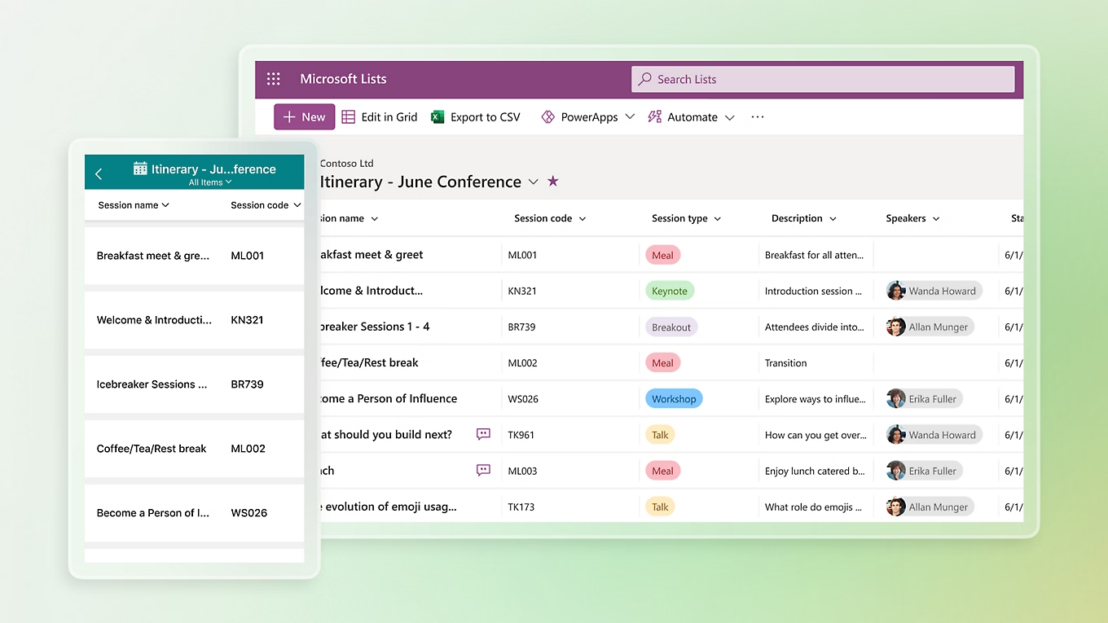
Introduction
What is Microsoft Lists
MS List is a tool for managing structured lists of data, similar to a simple database or table. It allows users to create, view, and manage information in a clear and organized way.

Slide 7

Key Functionalities of MS Lists

Slide 8

Key Functionalities of MS Lists
Create and Manage Lists
Custom Columns
Manage List Items
Custom Views
Conditional Formatting
Permissions and Sharing
Built-in Templates

Slide 9
Analyzing UI to Define Entities

Slide 10
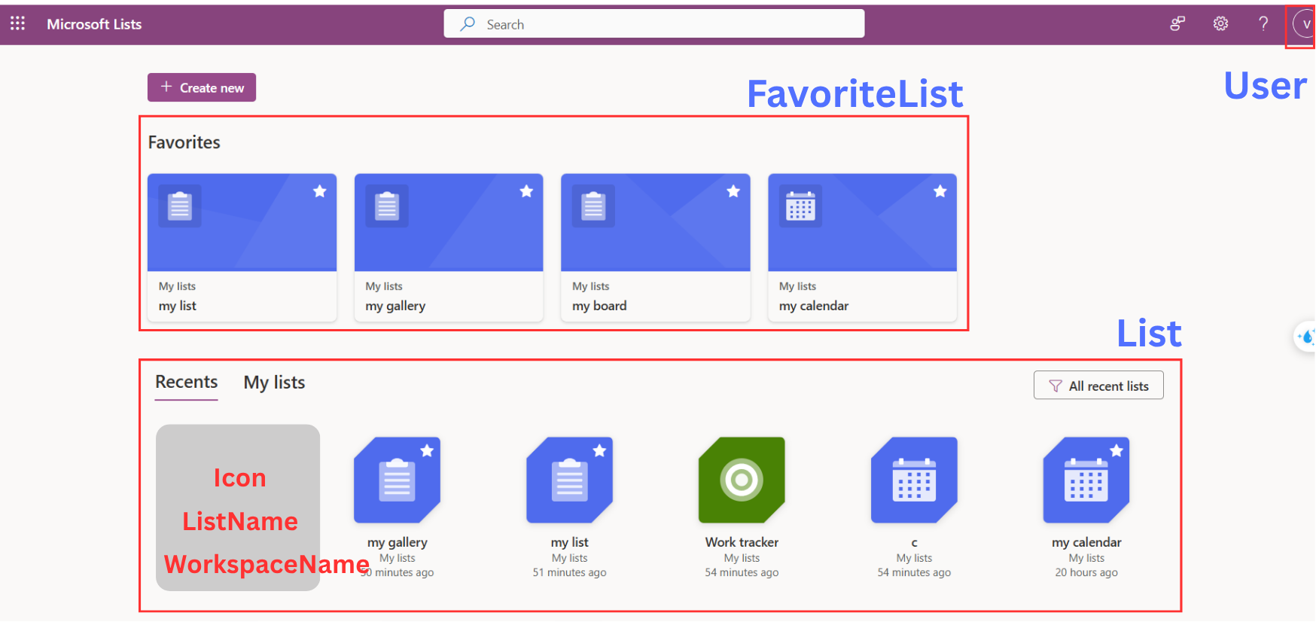
Dashboard

Slide 11
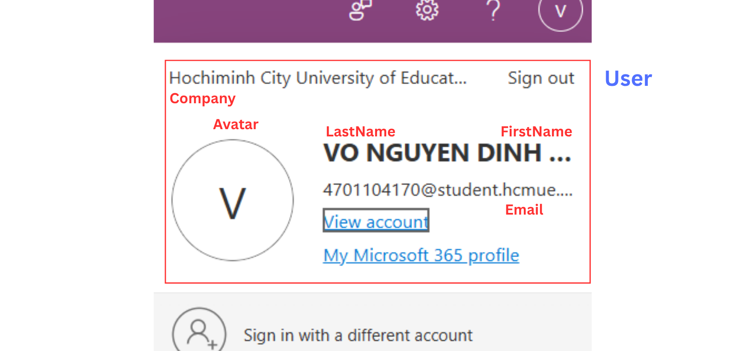
User

Slide 12
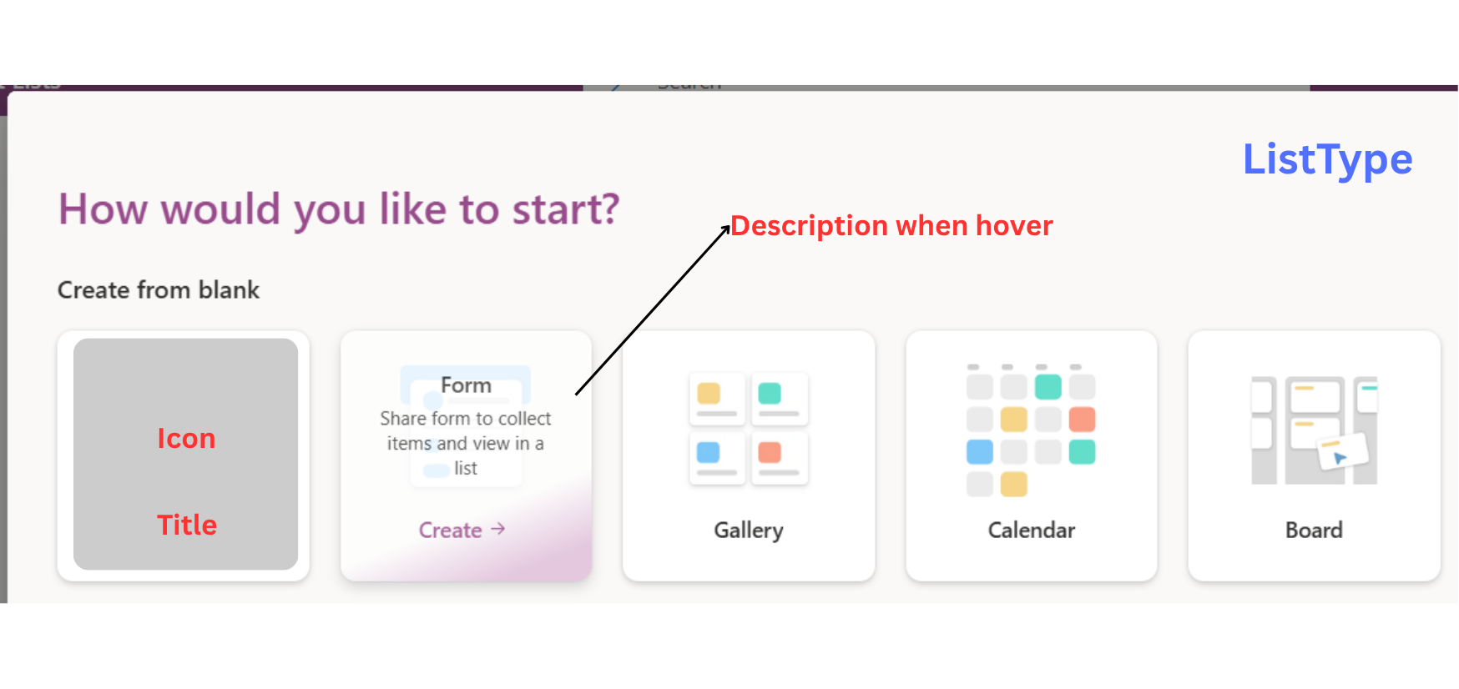
ListType

Slide 13
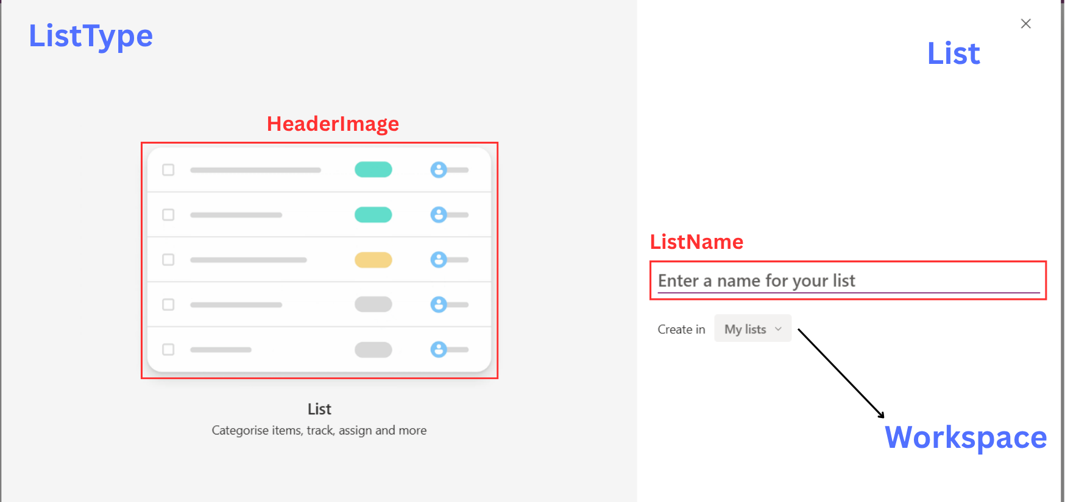
ListType, List & Workspace

Slide 14
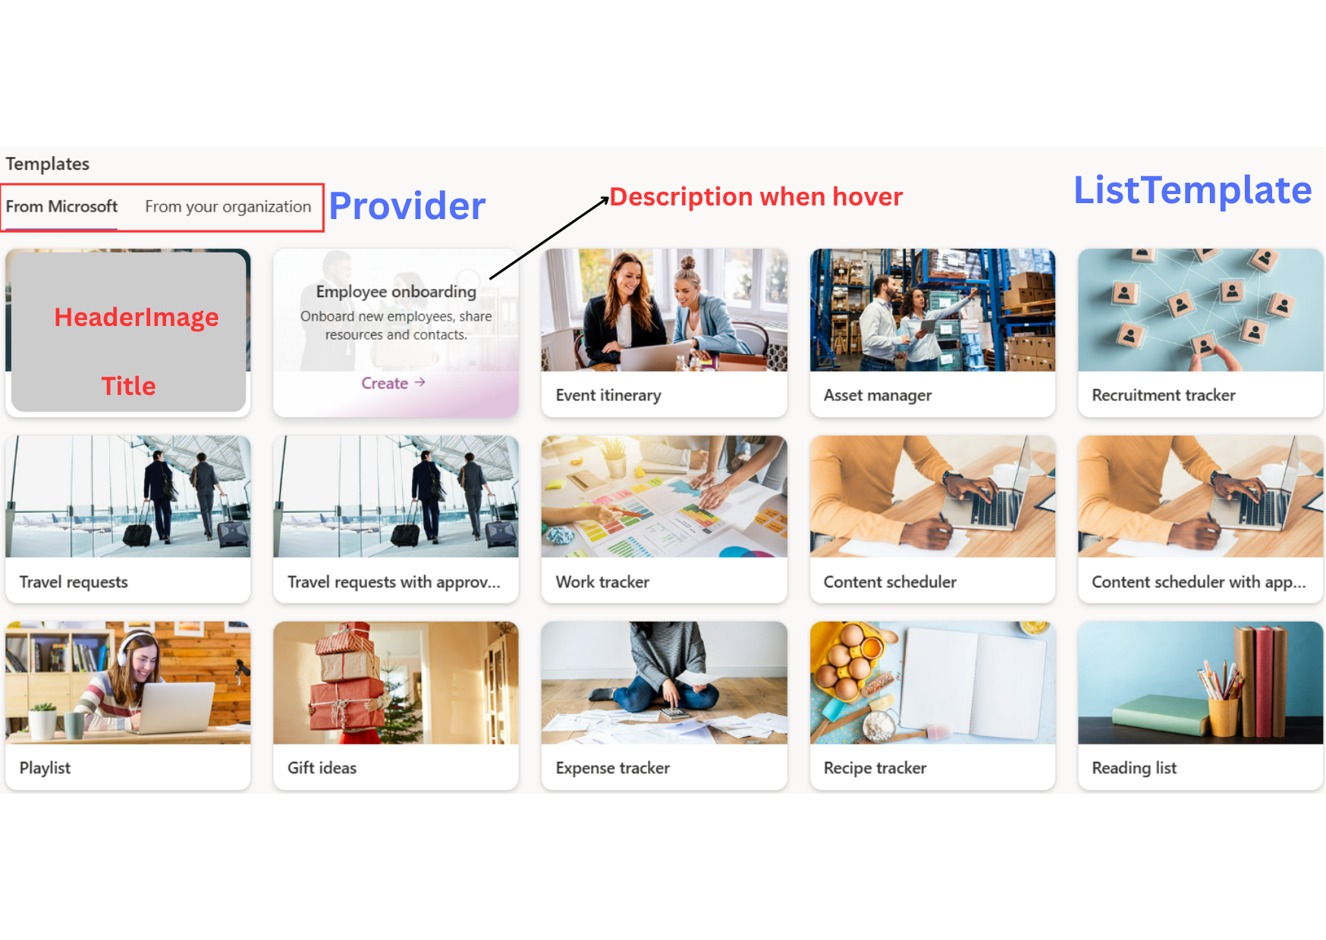
ListTemplate

Slide 15
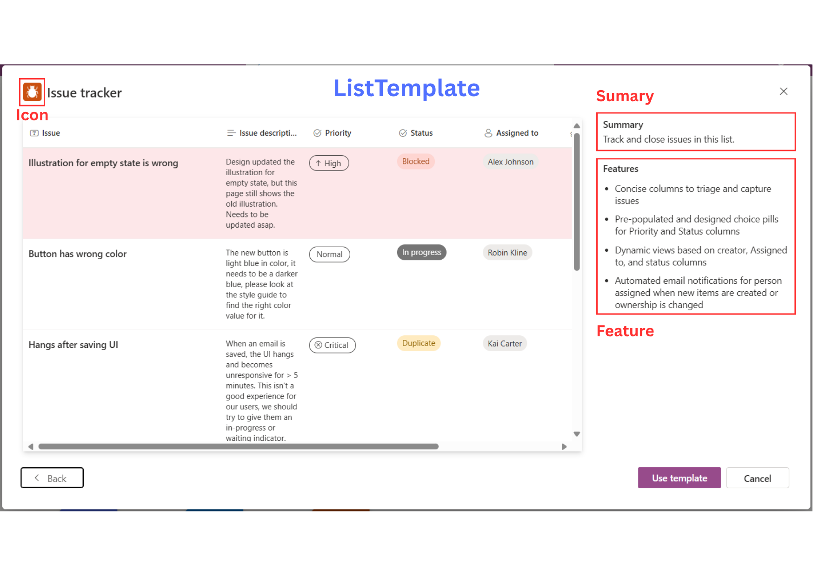
ListTemplate

Slide 16
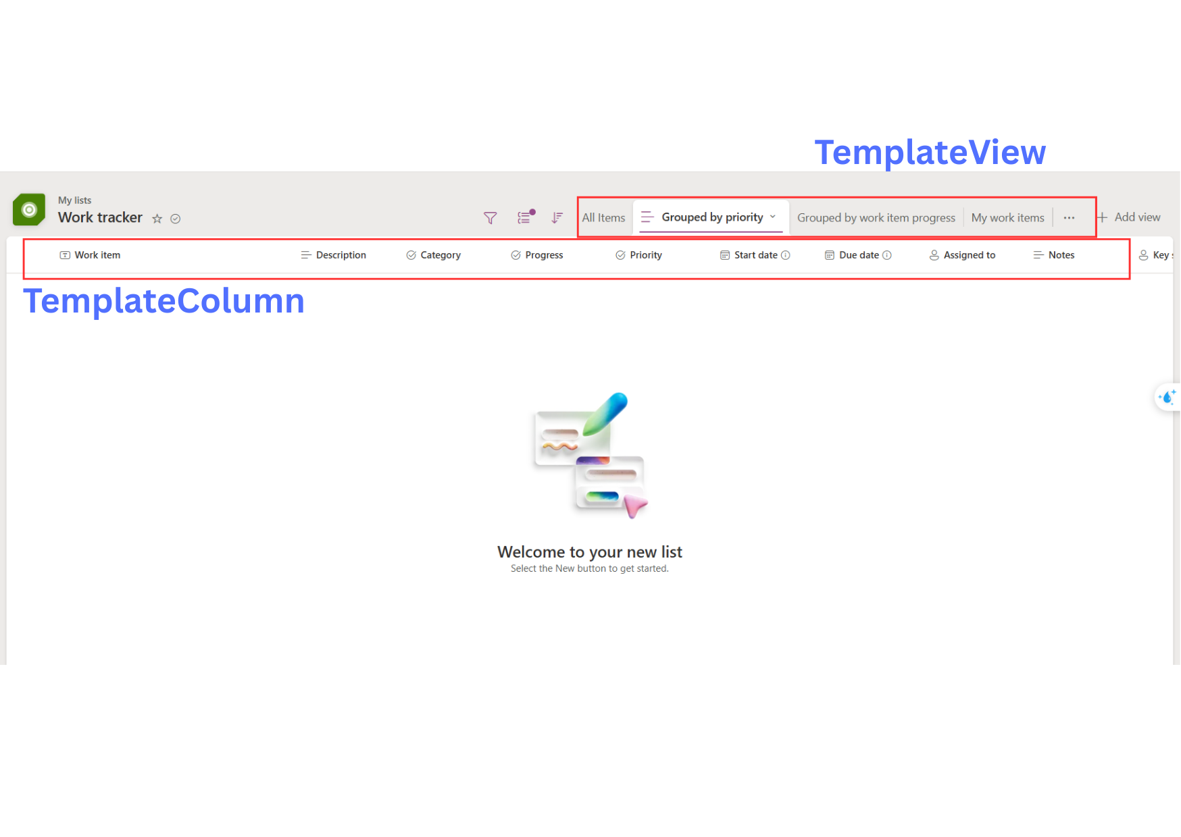
TemplateView & TemplateColumn

Slide 17
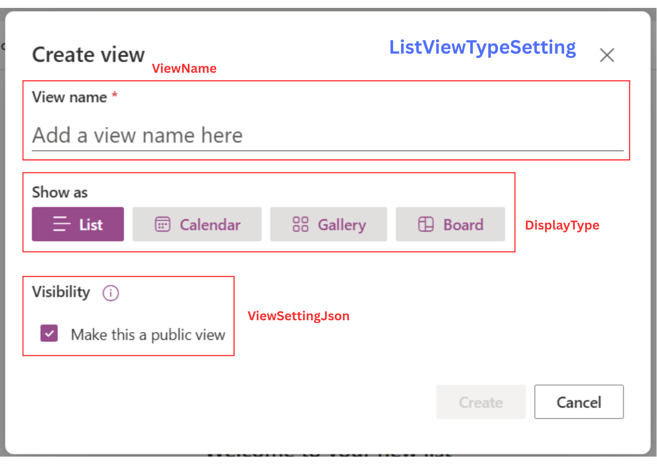
ListViewTypeSetting

Slide 18
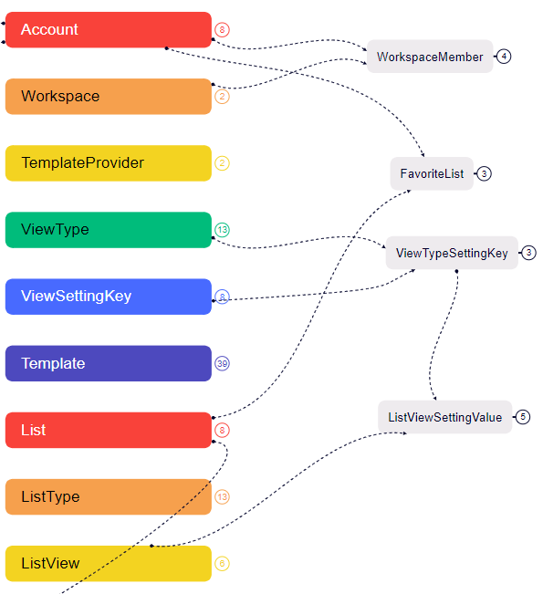
Mind Map Simplify for User, Template, List, View

Slide 20
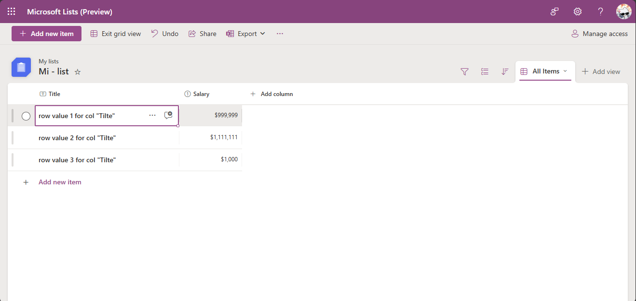

List
List DynamicColumn
List Column Value
List Row
1 List Row Value
1 ListRowValue has many ListColumnValue
List Column Value
List Column Value

Slide 21
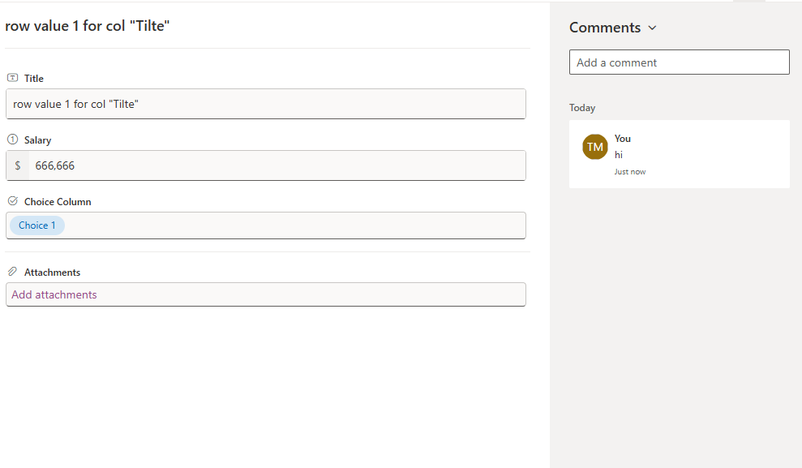
List Row - Comment
Comment
1 List Dynamic Column
1 List Column Value
Properties of Comment
Each ListRow may be associated with zero or more Comment entries.

Slide 22
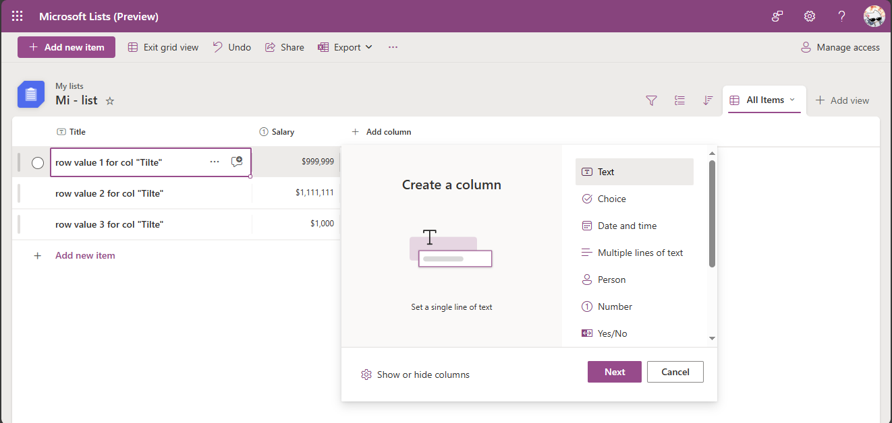
Custom Column
System DataType
1 List Column
Has 1
Properties of SystemDataType

Slide 23
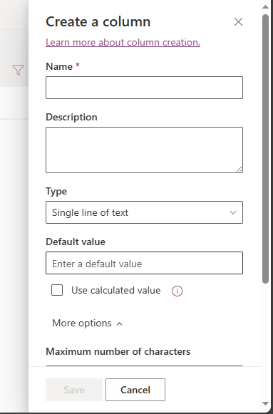
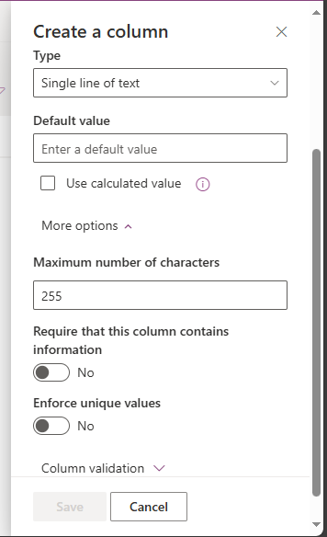
SystemDataType
Properties of ListColumn
KeySetting
SystemDataType
1 SystemDataType has many KeySetting
SystemDataType
KeySetting
KeySetting
KeySetting

Slide 24
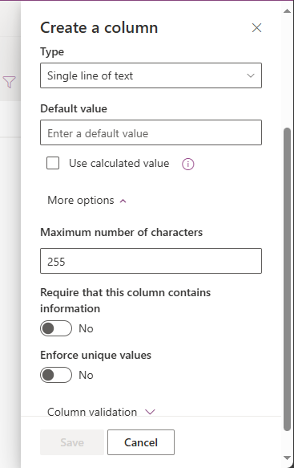
KeySetting
KeySetting has many “ValueType” as “ Text, Number, Boolean,…”.
1 KeySetting has 1 ValueType

Slide 25
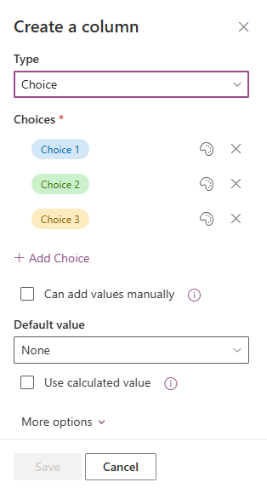
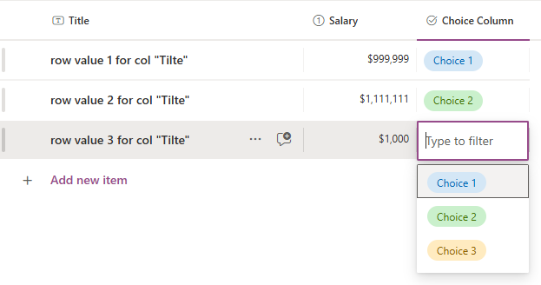
SystemDataType
ListColumnChoice
A ListColumn with a SystemDataType of Choice
will have one or more associated ListColumnChoice entries.

Slide 26
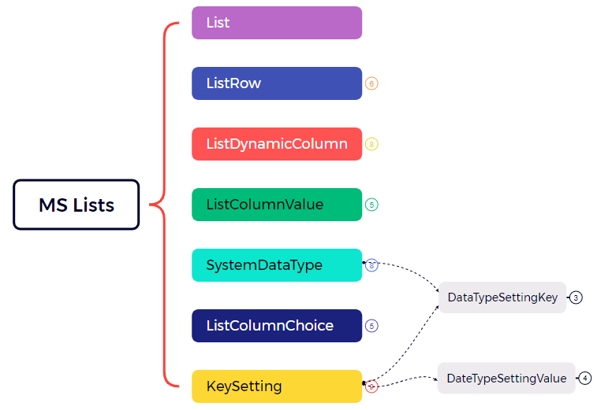
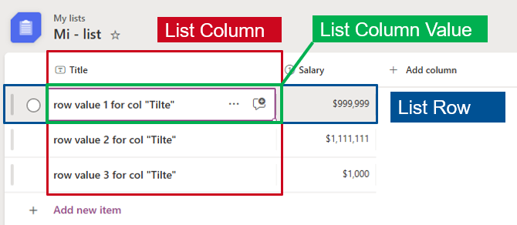

Mind map

Slide 27
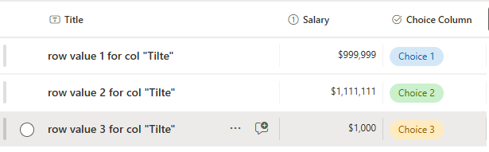
Mind map
1 ListDynamicColumn has 1 SystemDataType
The value of a ListColumnValue is determined based
on the value of its associated SystemDataType

Slide 28
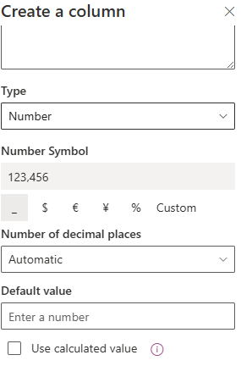
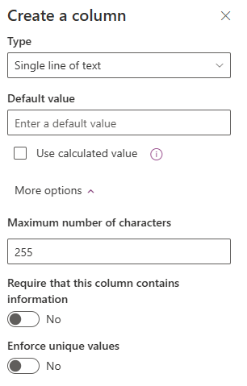
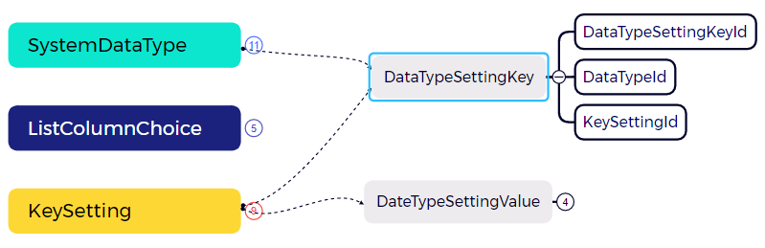
Mind map
The DataTypeSettingKey table defines how many KeySettings are associated with each SystemDataType

Slide 29
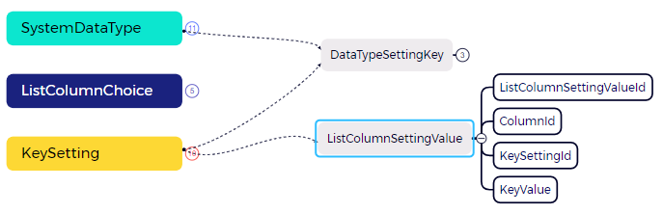
Mind map
KeySetting. ValueType:
Text
Number
Boolean
ListColumnSettingValue.KeyValue: 255
ListColumnSettingValue.KeyValue: False
The KeySetting table defines the ValueType for each setting key.
The ListColumnSettingValue table records the actual values assigned to each KeySetting for a given
ListDynamicColumn, based on its SystemDataType.

Slide 30
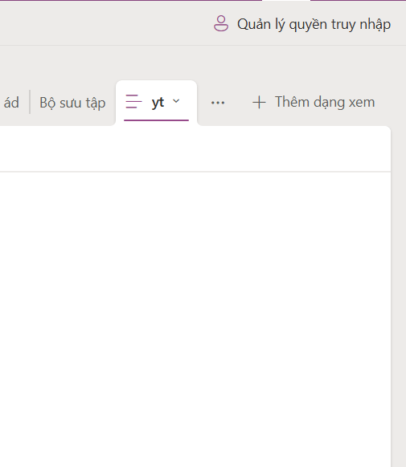

ShareLink
ShareLink
ShareLinkUserAccess

Slide 31
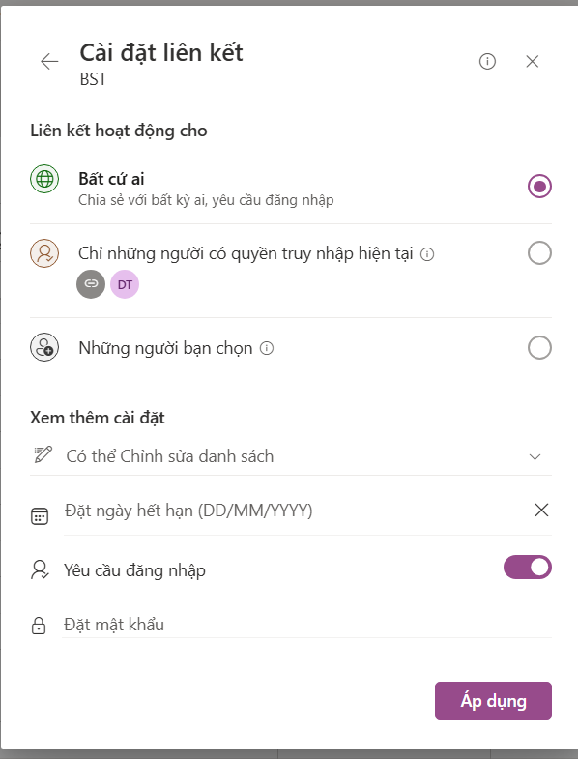
ShareLink
ListMemberPermission
ShareLink
Scope

Slide 32
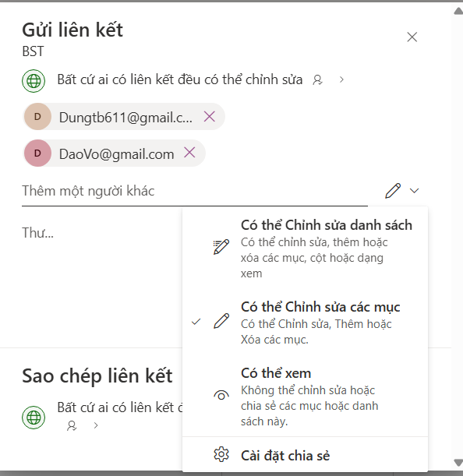
ShareLink
ShareLinkUserAccess
Permission

Slide 33
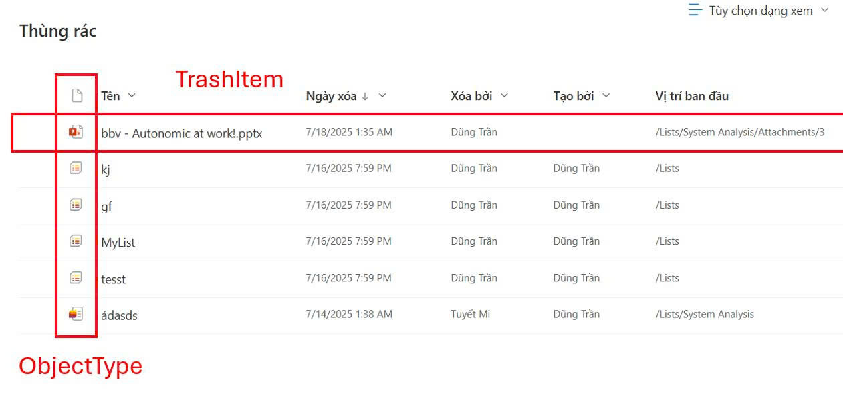
TrashItem

Slide 34
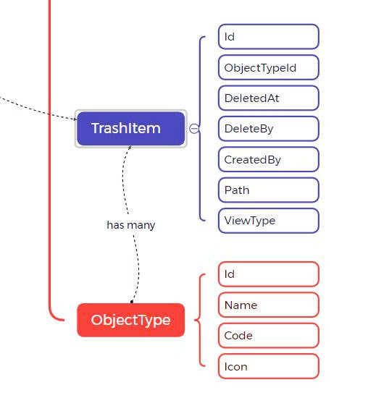
TrashItem

Slide 35
Database Structure
Main Features
List Management Features
Account
Workspace
FavoriteList
ShareList
List Member Permission
Trash
Activity
ChangeLog
Comment
Notifications
Permission
List
ListView
ListViewSettingValue
DynamicCol
ListColValue
ListRow
ViewType
DataType
KeySetting
File Attachment

Slide 36
Writing SQL Queries Based on MS Lists UI

Slide 37
Dashboard
1. Display all lists that the logged-in user created or were shared with them
2. Display all lists that the logged-in user created
3. Display information of the logged-in user
4. Display favorite lists of the logged-in user

Slide 38
Dashboard
DECLARE @UserId INT = 2;
SELECT DISTINCT
l.*,
lmp.HighestPermissionCode,
lmp.GrantedByAccountId
FROM List l
LEFT JOIN ListMemberPermission lmp ON l.Id = lmp.ListId AND lmp.AccountId = @UserId WHERE l.CreatedBy = @UserId
OR lmp.Id IS NOT NULL
AND l.ListStatus = 'Active';
GO

Slide 39
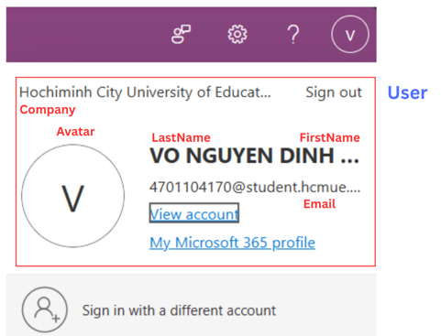
User
Display information of the logged-in user
DECLARE @UserId INT = 2;
SELECT
a.Id,
a.FirstName,
a.LastName,
a.Avatar,
a.Email,
a.Company,
a.AccountStatus
FROM Account a
WHERE a.Id = @UserId;
GO

Slide 40
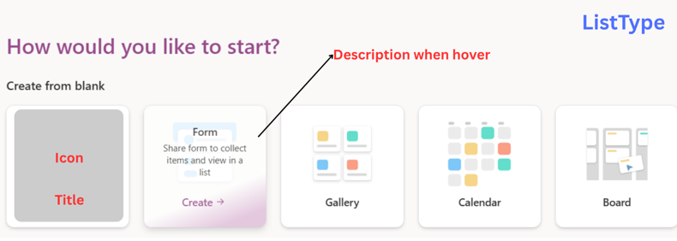
ListType
Display all list types for selection SELECT
Id,
Title,
ListTypeDescription,
HeaderImage
FROM ListType
ORDER BY Title;

Slide 41
ListType, List & Workspace
Display information of the selected l
ist type by the user DECLARE @ListTypeId INT = 3;
SELECT
Id,
Title,
Icon,
ListTypeDescription,
HeaderImage
FROM ListType
WHERE Id = @ListTypeId;
GO

Slide 42
ListTemplate

Slide 43
ListTemplate

Slide 44
SQL

Slide 45
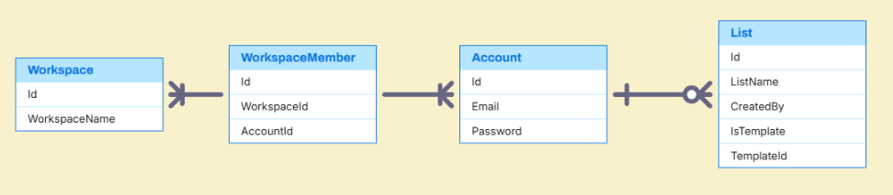
Workspace & List

Slide 46
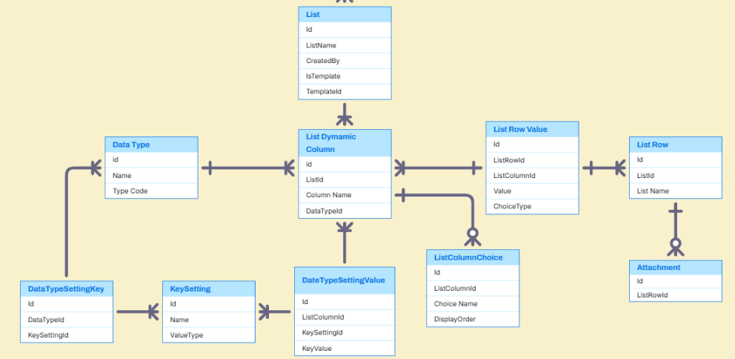
Custom Columns

Slide 47
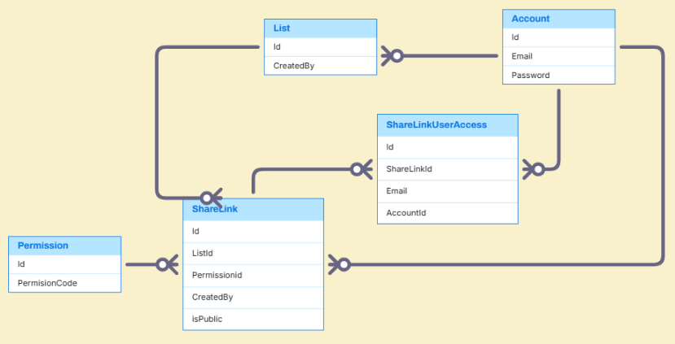
Share

Slide 48
Example data

Slide 49
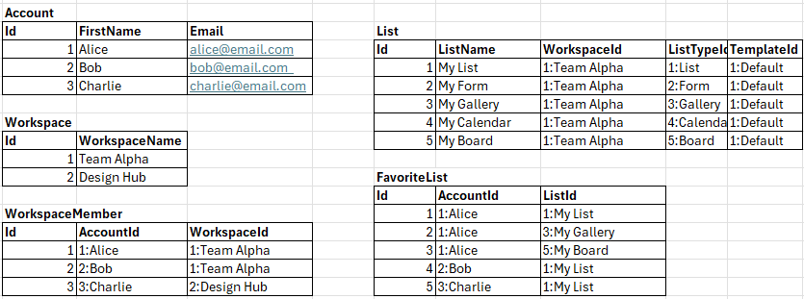
Example Data – Account, Workspace & List

Slide 50
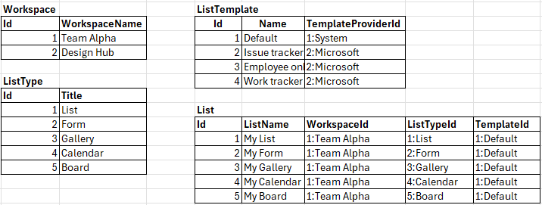
Example Data – List, ListType & ListTemplate

Slide 51
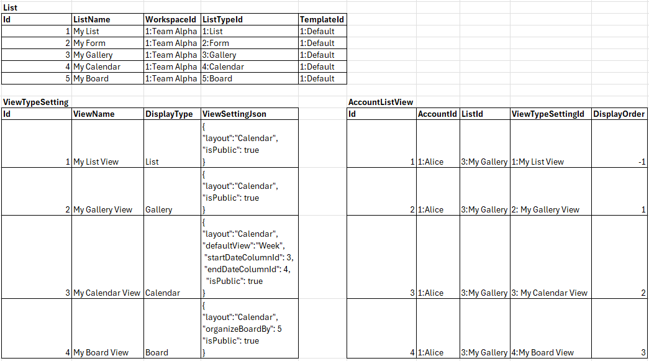
Example Data – List & View

Slide 52
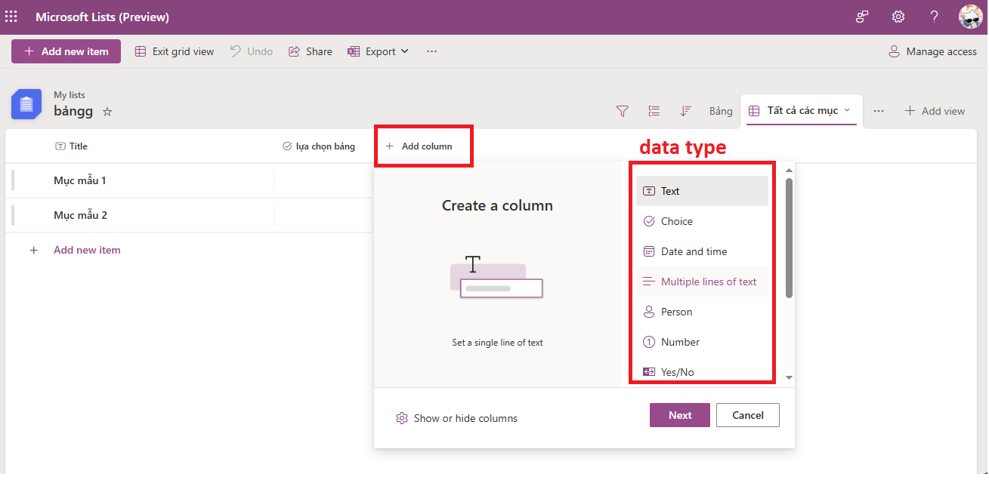
Example Data – Custom Columns

Slide 53
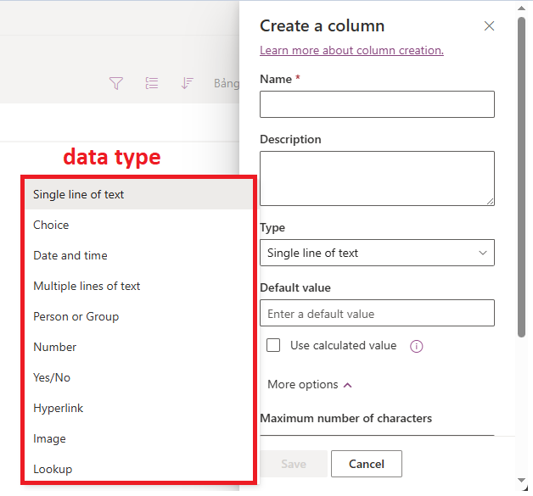
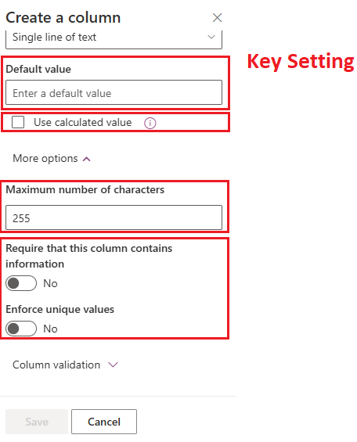
Example Data – Custom Columns

Slide 54
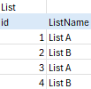
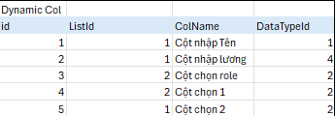
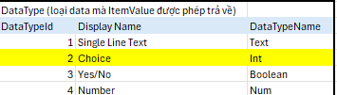
Example Data – Custom Columns

Slide 55
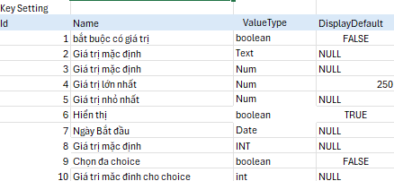
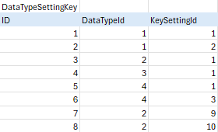
Example Data – Custom Columns

Slide 56
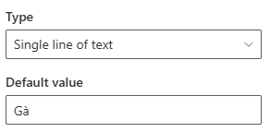
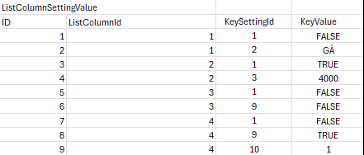

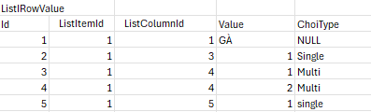
Example Data – Custom Columns

Slide 57
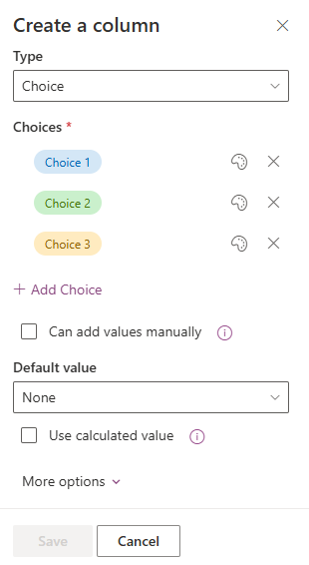

Example Data – Custom Columns

Slide 58

Example Data – Custom Columns

Slide 59


Example Data – Custom Columns

Slide 61
bbv template EN
Style guide

Slide 62



Working area, guides & ruler
Working area
Depending on the slide, a single-column layout, a 2-column or 3-column layout is used.
Display the ruler and guides in the «View» tab.

Slide 63


bbv colour theme
Always OK!
Never, please!
Default text colours
Main accent
Colours for diagrams, charts, graphs etc.
Use selectively and sparingly
Never, please!
Colours for diagrams, charts, graphs etc.
Colours for diagrams, charts, graphs etc.

